Slide 1
Bridgestone NZ Ltd: Electronic Job Card
End of Year Presentation
Presented by Scott Patterson

Slide 2
Presentation Agenda
Item 1
Item 5
Project Recap
Problems and Solutions
Item 2
Item 6
Future Potential Work
Motivation
Item 3
Work Flows
Item 7
What I Have Gained
Item 4
Item 8
Acknowledgements
Demonstration

Slide 3
Project Recap
“A mobile application needs to be developed for their electronic job card.
This is to emulate the manual recording of information on a job card to a Mobile device with a view linking ultimately to the Advanced Retail POS system.”
Project supervisors: Candy He, Philip Low, Akmal Akmaloni
Robert Lee
Notes:
As a reminder from the previous seminar, this is what the project is about, details
Need to add item information and at the end of the work flow be at a point to create an invoice in Advance Retail POS

Slide 4
Motivation
Currently:
- Bridgestone fleet technician will go off site and uses a paper platform to record information about the client and their vehicle
- Paper is given to a second employee to be keyed into the Point of Sales system to produce an invoice (inefficient)
Ideally:
- Bridgestone fleet technician will go off site with an electronic mobile device and record only new information, with all client and vehicle information that has been previously recorded, date and location auto populated
- Data is sent to database and able to be checked to easily produce an invoice, data does not need to be re-entered
Notes:
Frame as problem and solution, electronic solution to the problem of lack of effeciency.
As Vishal mentioned the solution is done with a Windows 8 app with the reasons he mentioned, so I won’t repeat.

Slide 5
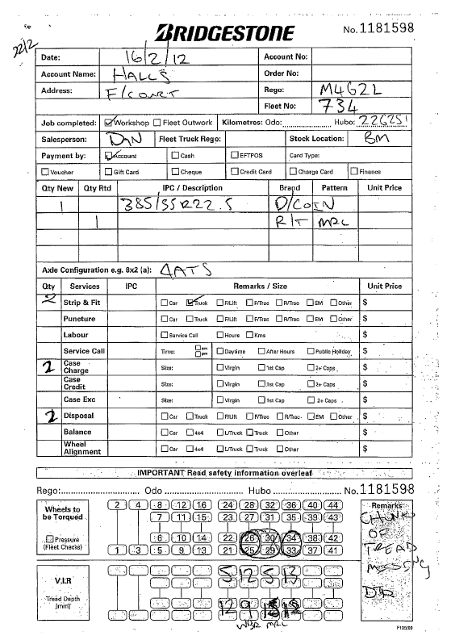
Current Work Process
Job Card
This is a scan of a paper Job Card currently in use which I attempt to replicate
Notes:
Stress simplicity, want it to feel natural by being similar, but talk about separate parts (Product IPCs, Services, Configuration),
I myself had a hard time understanding the sections so I try to make it feel natural without seeming foreign.

Slide 6

Motivation (additional)
Stock Lookup
    Based on meeting the Fleet Technicians they often needed to know where stock they needed was.
    Want to provide them a way of finding this information themselves without calling stores.
Incident Reporting
Currently two paper forms (Incident and Injury) are needed by Health and Safety Department.
Can provide an electronic form filling alternative.
Notes:
Additional SIMPLE functions which have potential
These are also problems which have room for space in the solution

Slide 7
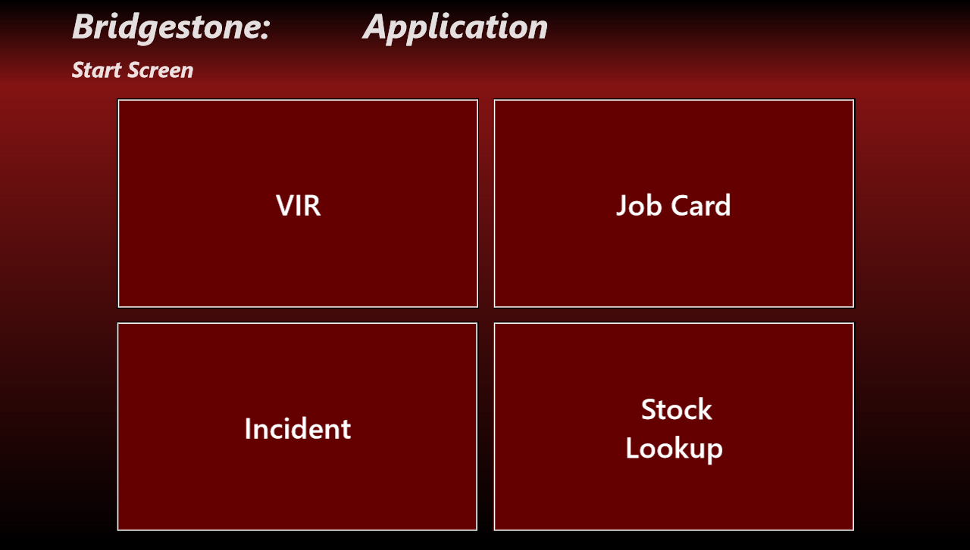
Motivation (cont.)
Combined all the functions into one – Why?
Notes:
Initially they were separate, why together (needless closing and opening, allows for more flexible work flows, gained permission)
Also helped with the addition of the SMALL additional functionality in a centralised app
This proves for a much better solution to the problems from a users perspective

Slide 8
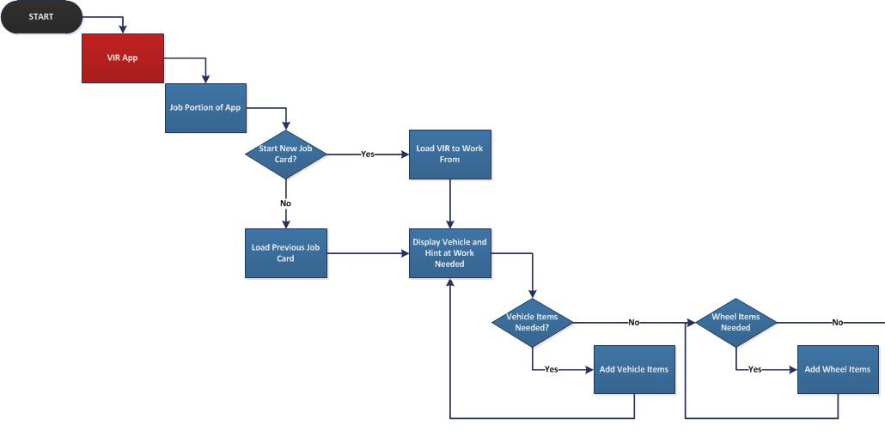
Work Flows – Job Card (1/2)
Notes:
As you will see, this is the work flow, Vishals comes before as a VIR is needed for the Job Card
Talk about the option points mainly, two places to enter items

Slide 9
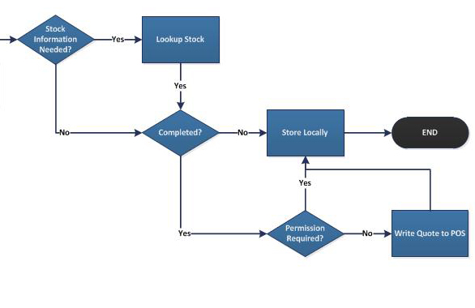
Work Flows – Job Card (2/2)
Notes:
All are stored locally, but in different situations that lead to the end
Also note stock lookup is accessible here

Slide 10
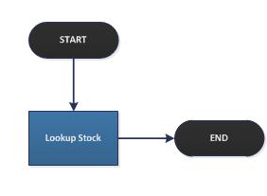
Work Flows – Stock Lookup
Notes:
Stock Lookup does not have to be inside that flow, it can be accessed by itself – not restrictive

Slide 11
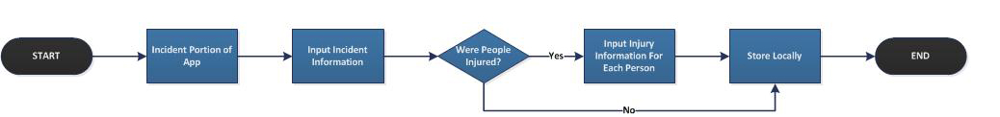
Work Flows – Incident Reporting
Notes:
Incident Reporting is a separate flow

Slide 12

Demonstration

Slide 13
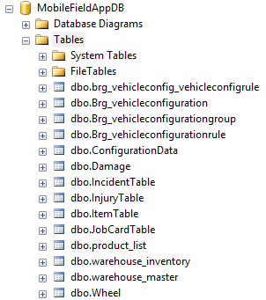
Demonstration
Notes:
Tables we used – Microsoft SQL Server Management Studio – GUI for easy visualisation (great as it was new to us)
It was consistent with their current use and easy to work with

Slide 14
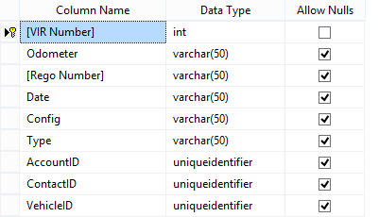
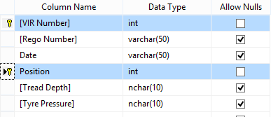
Demonstration
Notes:
To Read VIRs, this is the information I have access to – mainly looking at VIR Number, Rego and Config
No need to do the remote calls for this info

Slide 15
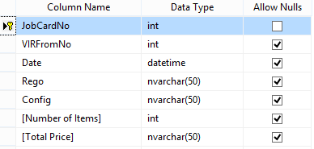
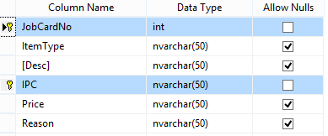
Demonstration
Notes:
To Read or Write Job Cards this info, has item info for populating the job cart

Slide 16
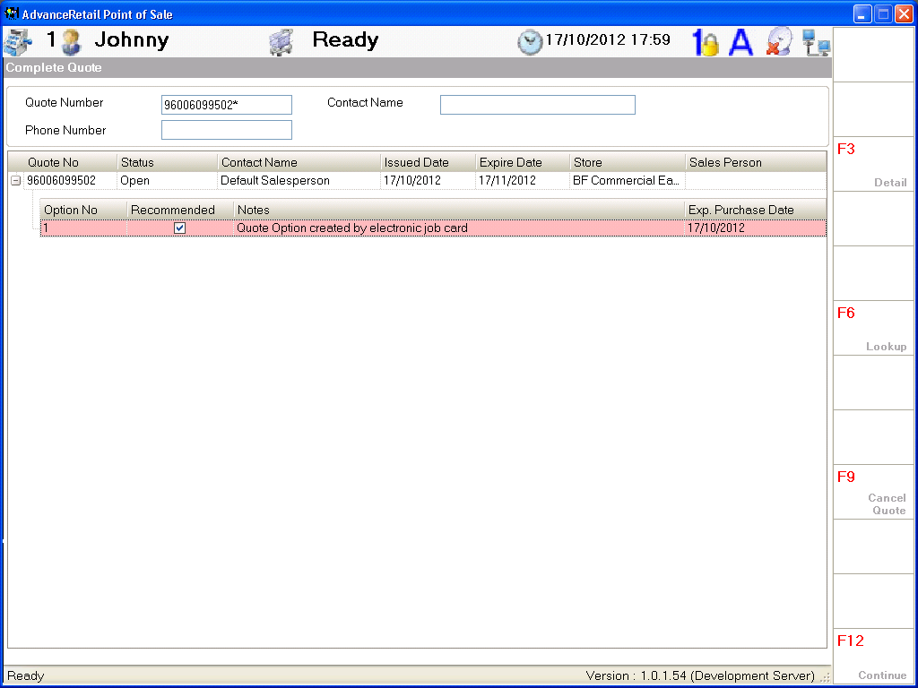
Demonstration
Notes:
Writing a Quote, looks like this in KeyStone, Advance Retail Point Of Sale System– Proof of End to End Process

Slide 17
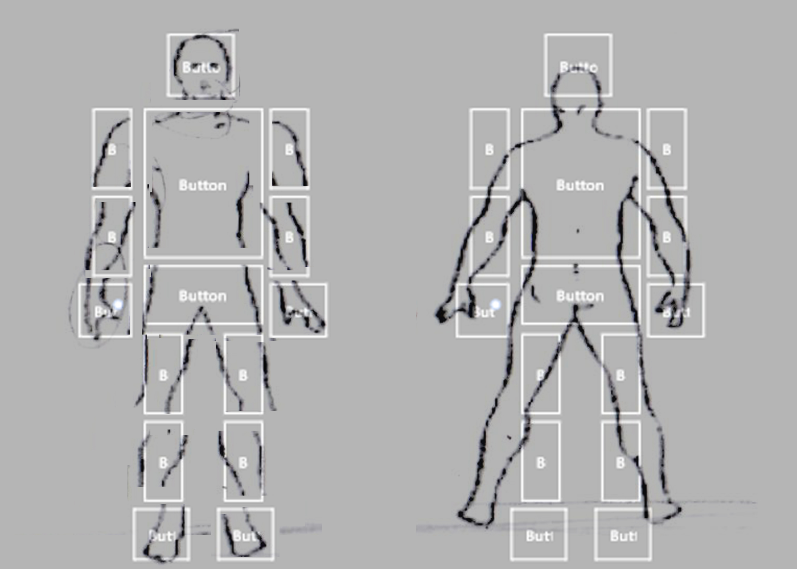
Demonstration
Notes:
I would have liked them to be images – As you can see here the cut up version and the whole version taken from the actual report
Photoshop cleanup skills weren’t quite up to par and I didn’t want to make it feel tacky with a scanned/not flowing image

Slide 18
Problems and Solutions
Problems Encountered:
Which device to develop for
Creating for Windows 8 requires a Windows 8 environment with development tools
Requiring a consistent invoice number
Requiring invoices to be printed
Jobs should be checked before an invoice is produced
Solution Found:
Windows 8 devices
A MSDN subscription was obtained allowing us to use beta development tools while working
Blocks of numbers can be used based on the database – No overlapping
Data is directly added to POS system which can print invoices based on that
Written as a quote

Slide 19
Problems and Solutions cont.
Problems Encountered:
Wanting to make work efficient if stock is needed
A lot of time was spent on researching functionalities and implementations
Syncing local and remote databases tables for use when unconnected
Solution Found:
An option for stock lookups to see what stock is where
Needed to spend extra time going into the offices
Will talk about next
Notes:
Give an example for this second point – Win 8 is new and lack of help available
Also date pickers are not currently part of Visual Studio 2012 for XAML, only HTML, external add-on was found

Slide 20

Future Potential Work
- Stock is currently a snapshot
- Writing Quote to POS is live
- Sending e-mails through the app when permission is required for work
- Saving signatures as images for sign-offs
- Dragging for swaps would feel natural
Notes:
Talk about syncing stock so it is more relevant, currently can be used offline but has to be manually updated and may be out of date – Alternative of manual
Talk about syncing things that require connections to local tables so they can be used offline – Quote maybe and CRM – Alternative of storing
Would have very much liked to do this, researched, but was constrained with time getting the functionality working, alternatives mentioned above.
E-mail, currently just prompts and could be handled by an external program, simple but cumbersome – alternative provided
Dragging would be great especially on a tablet, however with the sheer amount of buttons in very specific locations and the listview and gridviews not allowing me to keep that means it would be a lot of work – alternative provided

Slide 21

What I Have Gained
Infinitely more confident with XAML and C#
Experience with Windows 8 – New Technology
Experience with SQL and data handling
Knowledge of various mobile devices
Knowledge of syncing options
The importance of planning and feedback

Slide 22
Acknowledgements
I would first like to thank Bridgestone and BTech for giving me the opportunity to take part
Dr S. Manoharan for giving feedback on my progress and tips on where my focus should be throughout the semester
Robert A. Lee for trying to keep us organized by being involved and giving ideas
Candy He and Akmal Akmaloni for being available when they were
Philip Low for the immense amount of time he set aside to help, give advice, teach us how things worked or could work, and conveying details to and from Robert
Notes:
THANKS PHILIP

Slide 23

Questions?
Thank You

